Slide 1

10
Midterm preparation

Slide 2
1) What’s the difference between a pipe and a redirection?
• How could you simulate a pipe using only redirections?
2) What’s the difference between the pipe’s size and the piper’s buffer size?
3) What’s the difference between printf and echo?
4) In a script, how would you...
i) Refer to the second argument?
ii) Refer to the script’s name?
iii) Refer to the tenth argument?
iv) Lock the value of a variable?
v) End a ‘case’ structure?
vi) End a ‘while’ structure?
11
Midterm preparation

Slide 3
5) What’s the command to...
i) Duplicate a file?
ii) Relocate a file?
iii) Set the default permissions?
iv) Change the default permissions?
• What’s the difference between umask and chmod?
• What permissions will files have after umask 777?
• I start my laptop, go in the shell, type umask 777. Then I reboot. What are the permissions now?
v) Show the last lines of a file?
vi) Start emacs from the shell and detach it?
• What’s the difference between & and &&?
vii) See if the last command worked?
12
Midterm preparation

Slide 4
#!/bin/
echo "Yo. Wassup?"
if [ "$#" < "1" ]
then
echo "I do not know which file to remove."
else
rm $1
fi
6) What’s wrong?
#!/bin/bash
read "Please enter your annual income: " income
if [ "$income" -ge "0" && "$income" -le "9225" ]
then
echo -e "\nOh no! You are broke!\n"
elif [ "$income" -ge "9226" && "$income" -le “32000" ]
then
echo -e "\nYou better be cheap on things.\n"
else [ "$income" -ge “32001]
then
echo -e "\nYou are fine.\n"
fi
7) What’s wrong?
13
Midterm preparation

Slide 5
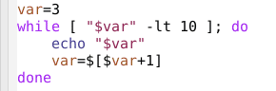
7) What shows up on the screen?
13
8) What shows up on the screen?
+2]
14
Midterm preparation

Slide 6
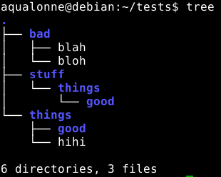
9) Draw the resulting structure.
mkdir -p stuff/things/good
mkdir things
mkdir bad
cd bad
lorem –p 3 > blah
lorem –p 3 > bloh
cd ../things
mkdir good
cd good
cd ../../things
lorem –p 3 > hihi
cd ..
rmdir things
15
Midterm preparation

Slide 7


